Slide 1
Collaboration Proposals for Tele-Sciences WG
Karpjoo Jeong (jeongk@konkuk.ac.kr)
Department of Advanced Tech. Fusion (http://atf.konkuk.ac.kr)
Konkuk University

Slide 2
Areas for Tele-Sciences WG
Technology
IT experts. IT tools
Domain Experts. Domain specific technologies
Applications (Problems)
Domain Experts
Infrastructures
Institutes capable of supporting infrastructures
Operation & Administration Experts
Human Networks

Slide 3
Technology
Applications
Infrastructure

Slide 4
Focuses or Goals ?
Common goals (visions) for WG
Don’t have be specific or targetable
Allow us to justify WG and to make specific plans
For example, we may know who to seek for or what technologies to look for
Each member of WG may have different goals or focuses
But he or she contributes to common goals and benefits from them

Slide 5
Strategy I (Big 2 Small)
Create Big Visions or Goals
Each member or institute tries to find areas for achievement or contribution

Slide 6
Strategy II (Small 2 Big)
Assume areas or solutions of each member
Aim at integration, interoperability and sharing

Slide 7
Strategy III (Mix)
Some members work on big goals; others work on small goals
WG provide coordination

Slide 8
A Proposal for Big Vision
Asia Ecological Observatory Networks (AEON)
We may take strategy III for AEON
Contribution may be made geographically and area-widely
Technologies
Applications (Domains)
Infrastructures

Slide 9
What We Are Doing Now (Projects)
MGrid: a Cyberinfrastructure for collaborative molecular simulation. Computing system and data sharing system
Seoul Metro Subway Indoor Air Quality Monitoring & Control
Seoul City Outdoor Air Quality Management and Ubiquitous Information Services
U-Eco City Client Platform Development
A sub-project of the Korea national u-City platform development project
Civil Engineering Data Management System for the KOCED Cyberinfrastructure (Civil Engineering Research Environments). KOCED is a Korea version of NEES
(Planning Stage). Korea Ecological Observatory Networks (KEON). Jeju Island Ecological Observatory (JEO)

Slide 10
What We Are Doing Now (Technologies)
Integrated Management Framework
Try to make framework as independent of application domains as possible
Use Data Turbine in most cases
Data Management and Sharing System
Focus on data sharing infrastructure
Started from Bio Sciences Domain; now trying to apply for Environmental, Ecological Science Domain

Slide 11
KEON/JEO
Jeju: Great Site for Ecological Research
Korea Meteorological Administration has developed advanced wireless mesh networks based meteorological sensor networks
Can be easily extended to support other types of sensors by wireless communication
A number of ecological research institutes in Jeju
Korea Ecological Observatory Networks/Jeju Ecological Observatory

Slide 12
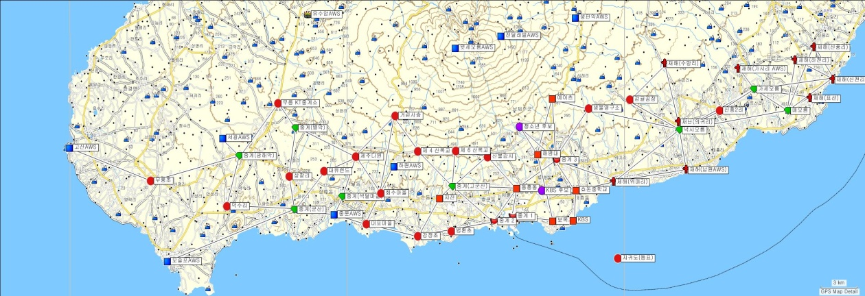
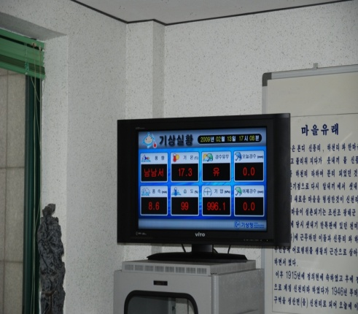
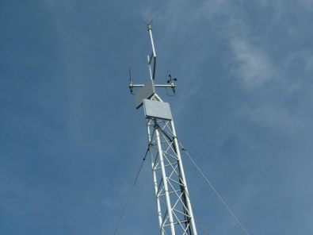
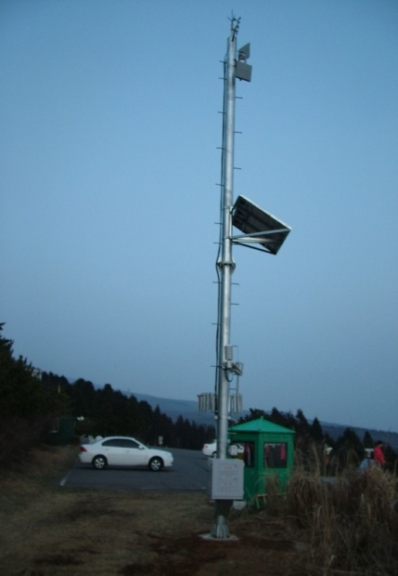
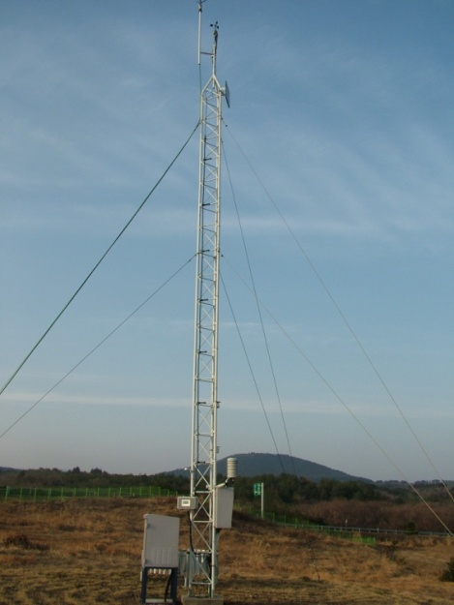
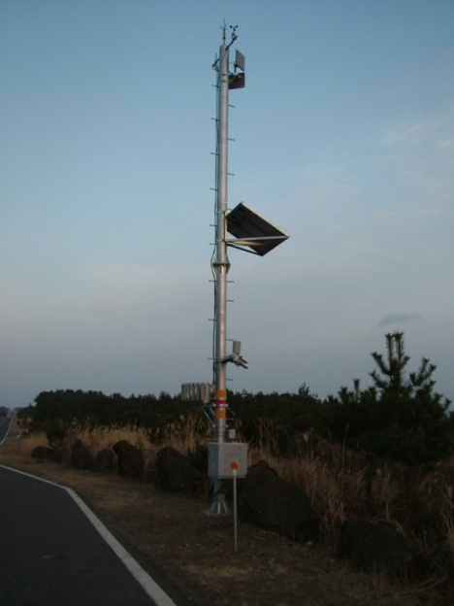
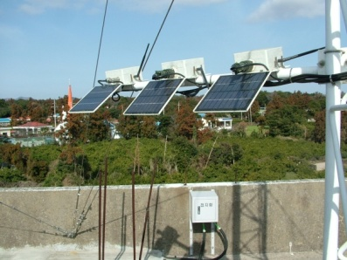
USN-based Integrated Meteorological, Ocean Monitoring System

Slide 13
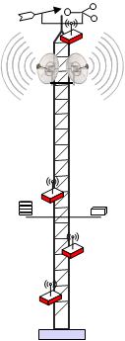
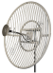
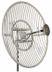
Wireless Mesh Networks
IP-USN1
IP-USN2
IP-USN3
IP-USN4
IP-USN5
IP-USN6
2.5Km
USN Meteorological observation system
IP-USN7
IP-USN8
2.5Km
IP-USN9

Slide 14
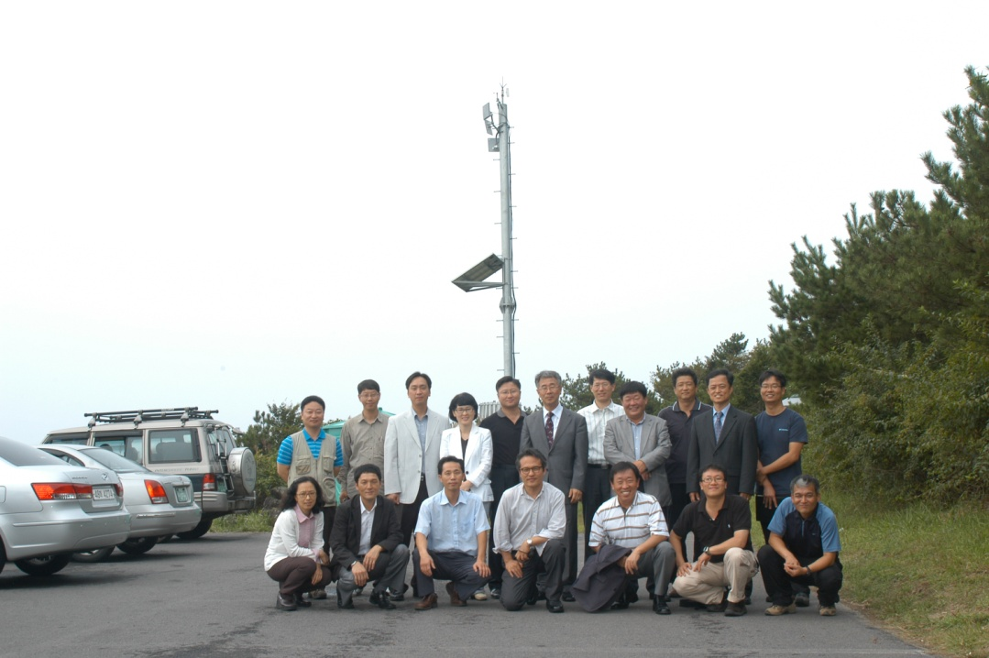
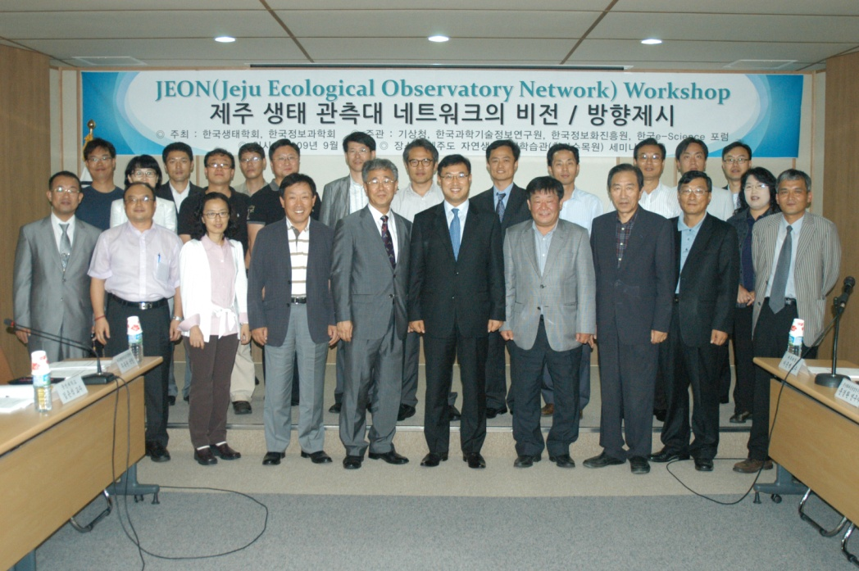
1st JEO Workshop on Sep. 29
2nd Workshop on Dec. 3~4

Slide 15
AirScope
This research was supported
by the Seoul R&D Program (GS070167)

Slide 16
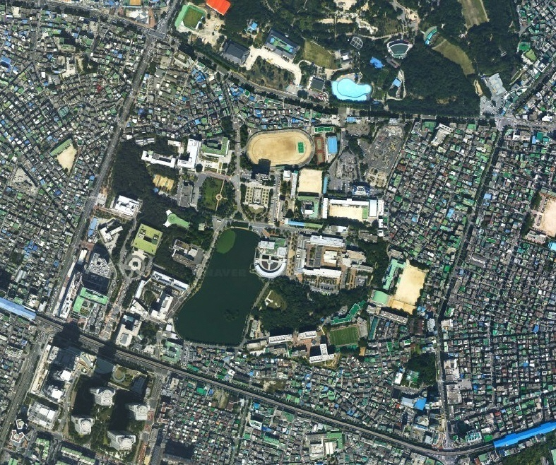
AirScope-KUC Testbed
1. Edu. & Ind. Building
2. KU Hospital
3. The college of law
4. Millennium Hall
5. Dormitory
6. The college of liberal arts
7. International Dormitory
8. The college of veterinary
(9.StarCity , 10. The Children’s Grand Park)
10
5
4
6
3
2
1
8
7
9

Slide 17
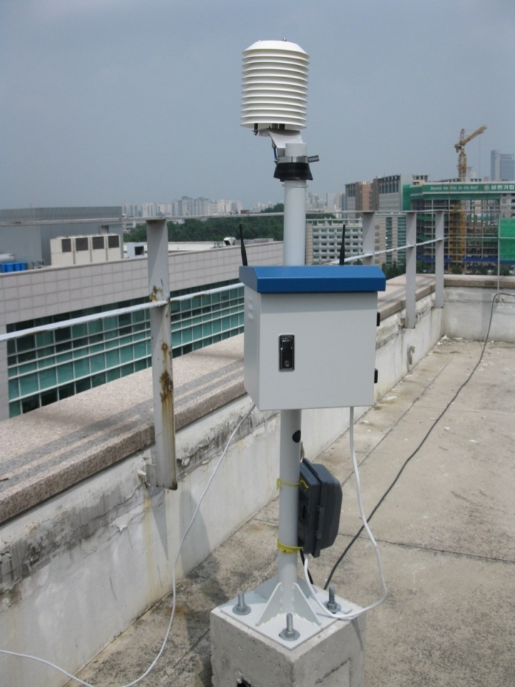
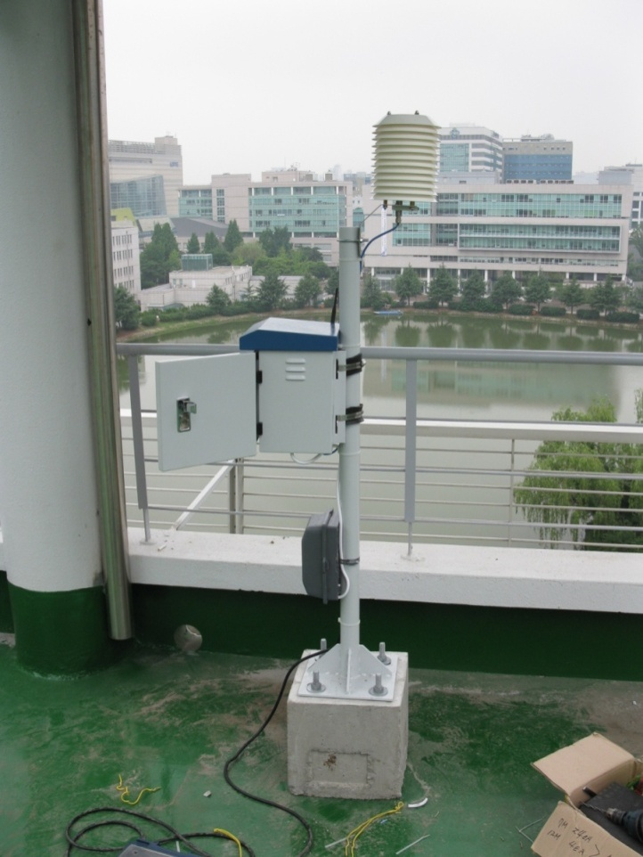
Sensor Package I - AirScope-KUC Testbed
Temperature, humidity monitoring sensor
CO, CO₂, dust monitoring sensor
Sensor Network Interface

Slide 18
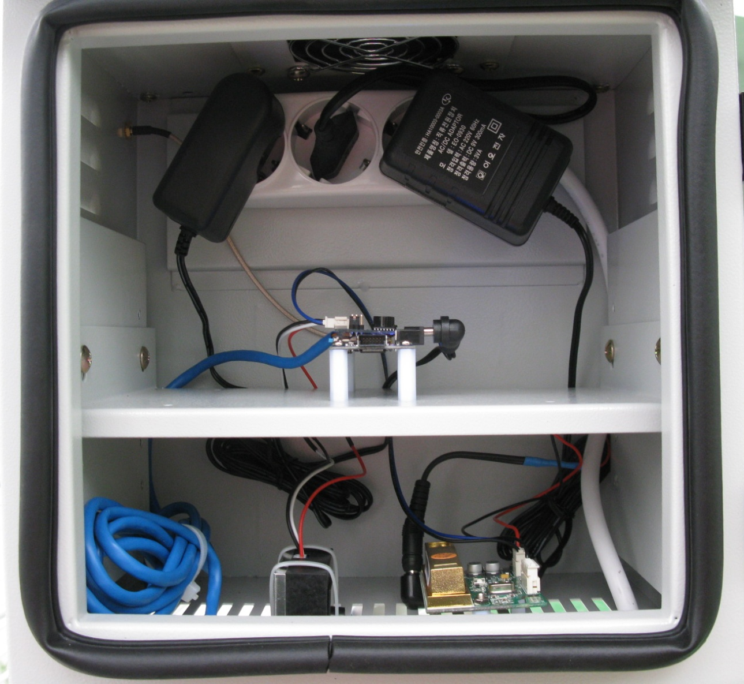
Sensor Package II - AirScope-KUC Testbed
Sensor network interface board
CO monitoring sensor
PM₁₀ monitoring sensor
CO₂ monitoring sensor

Slide 19
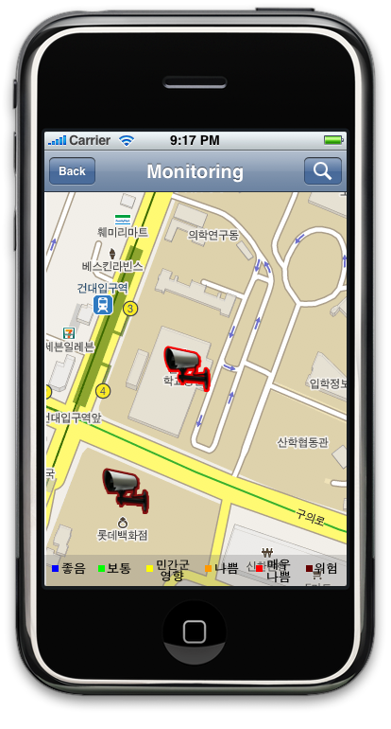
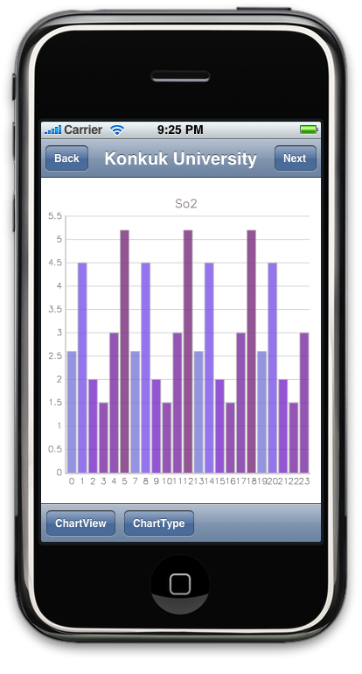
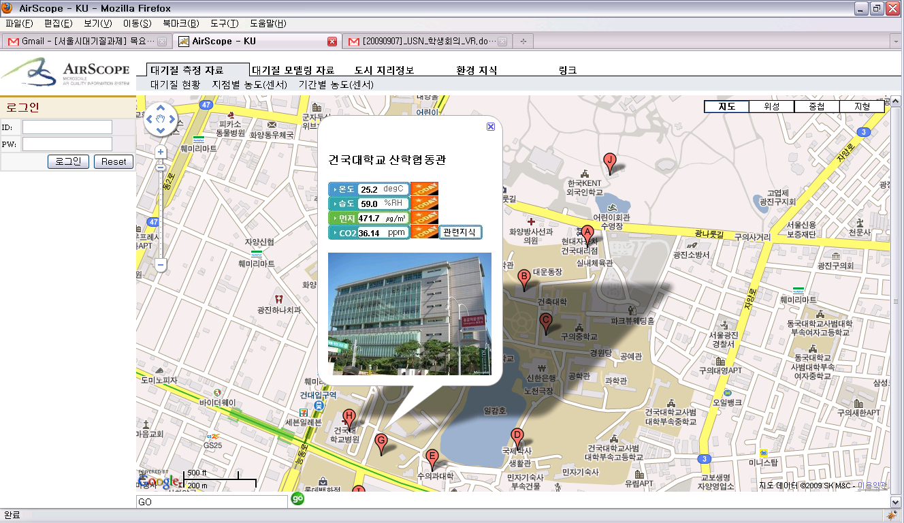
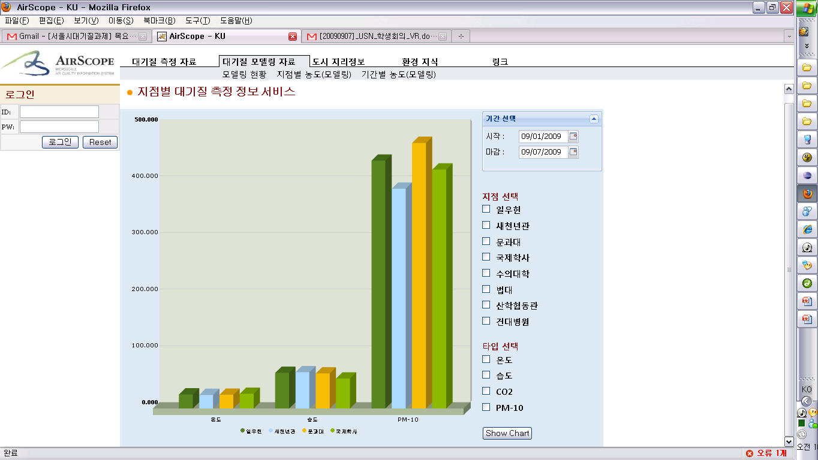
AirScope-KUC Prototype Services
IPhone-based Application
Desktop-based user portal
Real-time sensor data on google map
History data using 2D/3D charts
Notes:
시스템 컴포넌트 나열.
>>포탈서비스
- 데스크톱 기반 포털
- 모바일 기반 포털

Slide 20
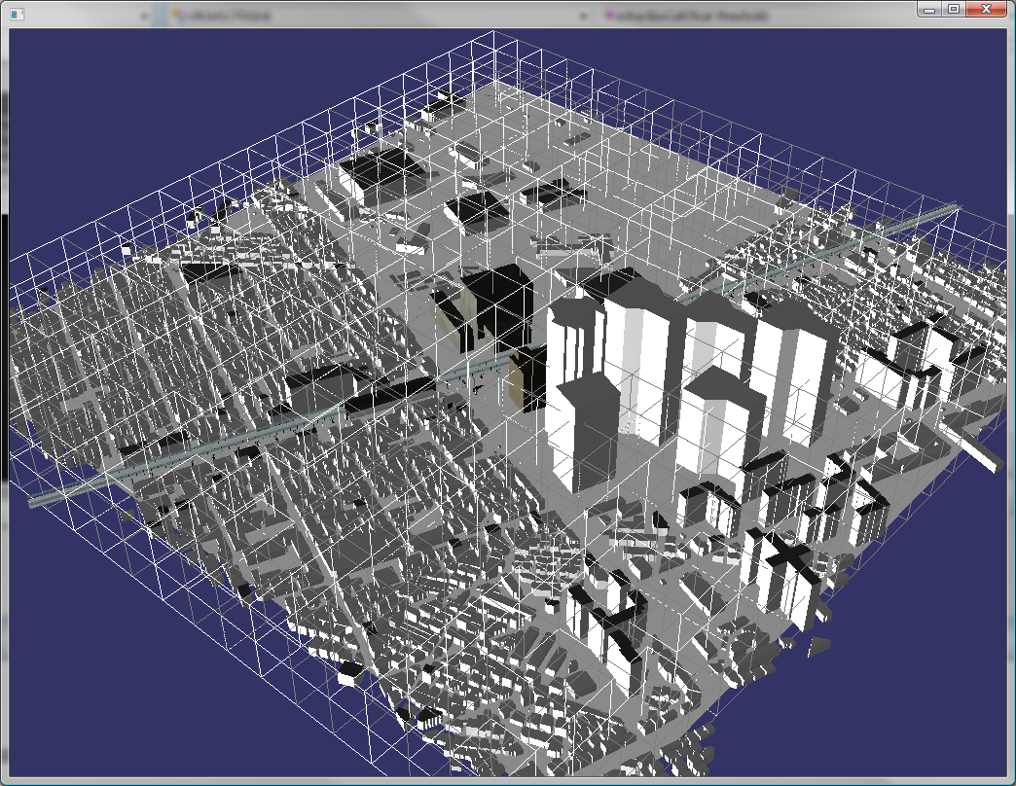
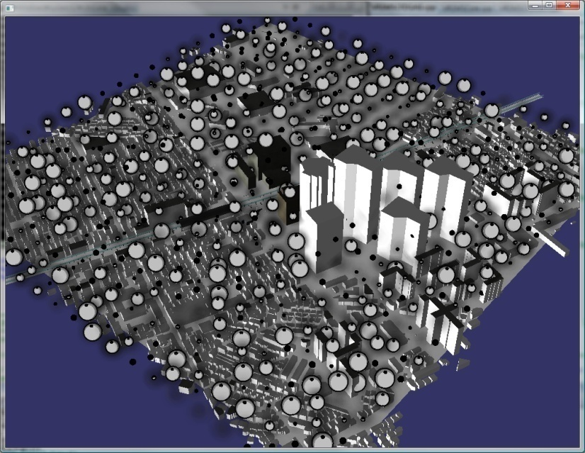
Visualization of Large-scale CFD Modeling
Large-scale real time CFD modeling data visualization
Adaptive data processing
Thin out unnecessary data
Improve entire performance
Emphasize important information
Non Photorealistic Rendering(NPR)
Notes:
우측 상단의 사진은 CFD 데이터가 가상으로 격자화 된 공간에 맞추어 들어오는 것을 의미 함
하단의 사진은 유저가 특정 값을 가지는 공간을 추출할 경우, NPR(비 실사 렌더링)에 의해 강조 된 marker가 생성되어 알아보기 쉽게 추출 되는 것을 의미 함

Slide 21
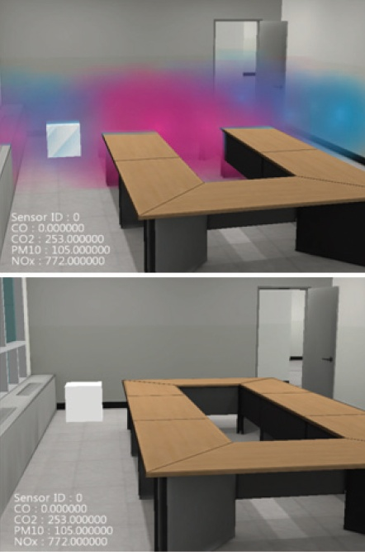
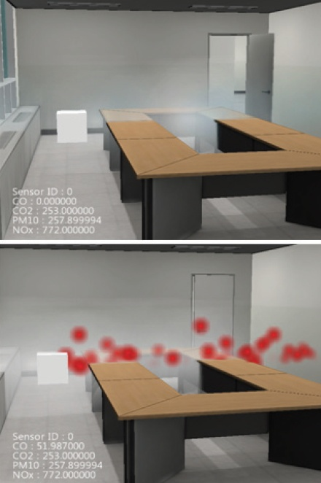
Virtual Reality based micro-scale air quality visualization(cont.)
Sensor monitoring
Visualize real-time sensor data
Multidimensional air quality data visualization
Set ‘Normal condition’ to thin out unnecessary data to visualize
If a air element exceeds normal condition, then visualize it
Numerical representation for experts

Slide 22
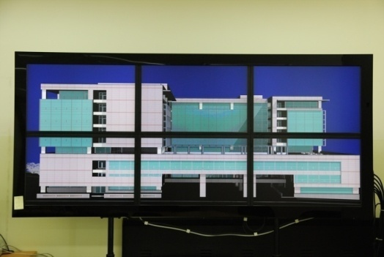
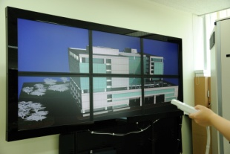
Air Quality Visualization using tiled display
Tiled large display system for improve user accessibility in public place
Multi-model interaction for IT-unfamiliar such as eldery or handicapped people

